Slide 1

Welcome to 2W
Miss Whitfield
Mrs Spragg

Slide 2
Welcome
The aim of this PowerPoint is to provide you with some insight into Year 2 and how we aim to support your children throughout the year.
If you have any queries following this please email parentalconcerns@trinitybuckshaw.lancs.sch.uk and address FAO Year 2 and we will endeavour to answer any question.

Slide 3


Keep up-to-date
*Our Instagram page @trinitycemethodistprimary
Our School app
Seesaw for homework grids and activities

Slide 4
Transition to Year 1
In Year 2 we are working towards more structured learning with a reduction in play based learning activities. However we still have lots of fun!
Children complete the same lessons as they did in Year 1 and still have access to some activities in our provision for Maths and English when appropriate.

Slide 5
Independence
Please help us to create independent learners by encouraging your child to:
Take responsibility for their belongings
Prepare for PE lessons by learning to put on and take off their own uniform, including fastening their own school shoes. PE lessons are on a Wednesday and Friday.
Work independently (including for homework- once they understand the task)
Persevere with tasks, even when they find something tricky
Ask questions when they are unsure
We want to work with you to create independent, resilient young children who are thriving both in school and at home.

Slide 6
Throughout your child's time in school they have learnt the Trinity behavior expectations.
We reward children with verbal praise, stickers, golden tickets and house team points for Christian Values.
Golden tickets enter your child into a lucky draw whereby they can win a tea party with Mrs Wright.
The House team which gains the most team in a half terms receives an extra play time with the equipment.
Behaviour system

Slide 7
Behaviour system
In Year 2 we continue to use a visual reminder for behaviour however it is slightly different to Year 1 as the children have learnt about the school rules fully by now.
All children start the morning and afternoon on Green for good behaviour.
Children not following behaviour expectations will firstly receive a verbal warning. If this behaviour continues the child will move their name to the red for stop coloured card.
For repeatedly not following behaviour expectations or serious incidents the child will move their name to yellow, for a yellow sheet.
Then the following procedures will take place:
1 Yellow sheet = missed playtime
2 Yellow sheets = see Miss Corrigan or Mrs Smith
3 Yellow sheets = Red sheet = see Mrs Wright or Mrs Corrigan

Slide 8
The Year 2 Curriculum

Slide 9
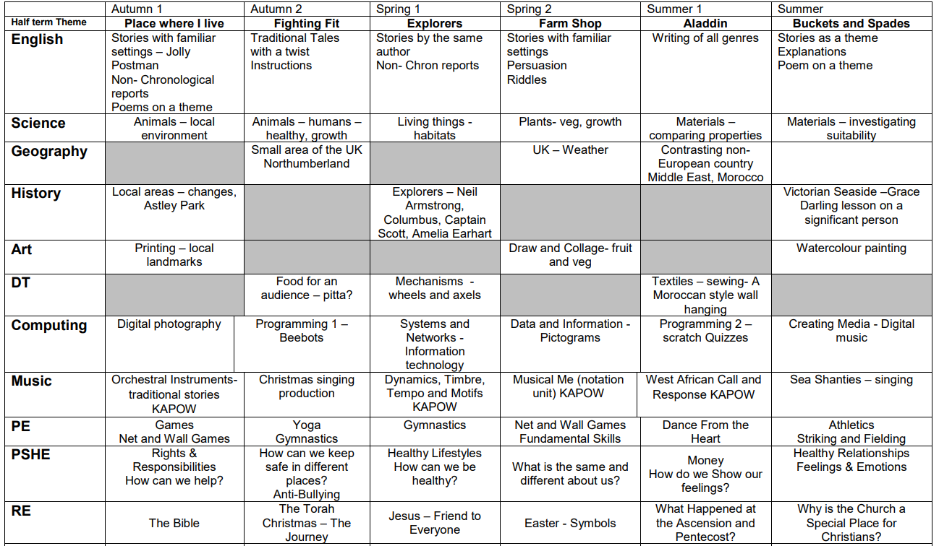

Slide 10
Phonics
We continue with Little Wandle phonics for the first half term before moving onto a spelling programme.
The spelling programme continues over the year building on your child's knowledge of spelling rules and application.
If a child still finds phonics tricky they will continue to receive support with this.

Slide 11
Guided Reading
Children will read twice a week in school with an adult.
Read 1- will focus on application of phonics
Read 2- will focus on comprehension
Children will bring home their new reading book on a Friday.
Our Reading Diaries are for you to record when you have read with your child. In school we have a ‘We Are Reading’ incentive. If your child has read three times in a week they will receive a ticket for the prize draw. They can then win a book of their choice I they have a ticket chosen at the end of each half term.

Slide 12
How can I support my child in reading?
Encourage your child to read - anything and everything!!
Discuss books
In the front of the reading diary we have added a sheet with support ideas for reading at home.

Slide 13
Homework
A homework grid will be posted on our website and on Seesaw for each half term.
Children should respond to the activities on their Seesaw journal where possible, posting photographs or videos if appropriate.
You will find your child’s own personal log in attached to the cover of their reading journal.

Slide 14
As always, we are grateful for your support with our learning and homework in Year 2.
We are looking forward to a fun filled year with your children- if you have any concerns please feel free to talk to us, pass on a note or email the school.
parentalconcerns@trinitybuckshaw.lancs.sch.uk

