Slide 1

Welcome to 2W
Mrs Walker
Mrs Cockroft
2P: Miss Price
2G: Mrs Glayzer

Slide 2
Welcome
The aim of this afternoon is to provide you with some insight into Year 2 and how we aim to support your children throughout the year.
If you have any queries please email parentalconcerns@trinitybuckshaw.lancs.sch.uk and address FAO Year 2 and we will endeavour to answer any questions.

Slide 3


Keep up to date
*Our Instagram page @trinitycemethodistprimary
Our School app
Seesaw for homework grids and activities

Slide 4
Transition from Year 1
In Year 2 we are working towards more structured learning with a reduction in play-based learning activities. However, we still have lots of fun with your children and understand that this is a big change for them!
Children complete the same lessons as they did in Year 1 and still have access to some activities in our provision areas for Maths and English when appropriate.

Slide 5
Independence
Please help us to create independent learners by encouraging your child to:
Take responsibility for their belongings
Prepare for PE lessons by learning to put on and take off their own uniform, including fastening their own school shoes
Work independently (including for homework- once they understand the task)
Persevere with tasks, even when they find something tricky
Ask questions when they are unsure
We want to work with you to create independent, resilient young children who are thriving both in school and at home.

Slide 6
Our behaviour approach
Throughout your child's time in school, they have learnt the Trinity behavior expectations.
We reward children with verbal praise, stickers, golden tickets and house team points.
Golden tickets enter your child into a lucky draw whereby they can win a tea party with Mrs Wright.
The House team which gains the most team in a half terms receives an extra play time with the equipment.

Slide 7
In Year 2 we continue to use a visual reminder for behaviour however it is slightly different to Year 1 as the children have learnt about the school rules fully by now.
All children start the morning and afternoon on Green for good behaviour.
Children not following behaviour expectations will firstly receive a verbal warning. If this behaviour continues the child will move their name to the red for stop coloured card.
For repeatedly not following behaviour expectations or serious incidents the child will move their name to yellow, for a yellow sheet.
Then the following procedures will take place:
1 Yellow sheet = missed playtime
2 Yellow sheets = see Mrs Little or Mrs Birchall
3 Yellow sheets = Red sheet = see Mrs Wright

Slide 8
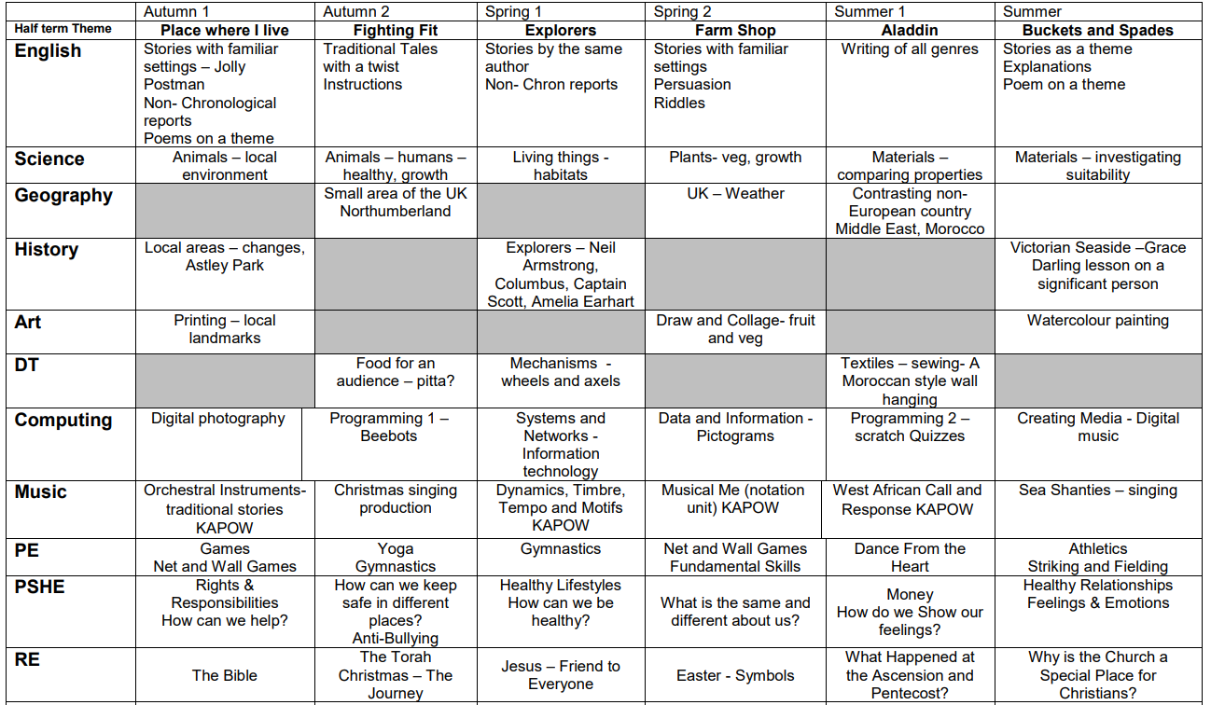
Year 2 Curriculum

Slide 9
Phonics
We complete a Phase 5 phonic recap through our spelling scheme in Autumn 1. We will then move onto Red Rose Spelling in Autumn 2.
The spelling programme continues over the year building on your child's knowledge of spelling rules and application.
If a child still finds phonics challenging, then they will continue to receive support with this and have the same daily phonics sessions as in Year 1.

Slide 10
Guided Reading
Children will read twice a week in school with an adult.
Read 1- will focus on application of phonics
Read 2- will focus on comprehension
Children will bring home their new reading book on a Friday.
Children still accessing Phonics lessons will read 3 times per week, just like last year.
Our Reading Diaries are for you to record when you have read with your child. In school we have a ‘We Are Reading’ incentive. If your child has read three times in a week they will receive a ticket for the prize draw. They can then win a book of their choice if they have a ticket chosen at the end of each half term.

Slide 11
Reading at Home
Encourage your child to read - anything and everything!!
Discuss books
In the front of the reading diary we have added a sheet with support ideas for reading at home.
Reading books are changed on Fridays.

Slide 12
Homework
A homework grid will be posted on our website and on Seesaw for each half term.
Children should respond to the activities on their Seesaw journal where possible, posting photographs or videos if appropriate.
You will find your child’s own personal log-in in the cover of their reading journal.

Slide 13

At home learning
Numbots/ Times Tables Rockstars
Reading each night at home (at least 3x per week)
Little Wandle phonics – parent section of the website has some resources for you and information to help you
Encourage writing opportunities at home

Slide 14
P.E
Our PE days are on Monday and Wednesday
Children should have a full indoor and outdoor PE kit in school every day, which includes black trainers (not pumps)
Earrings should be removed on PE days. If you are still within your 6 week window after having them pierced, then children should have tape covering their earrings when they arrive in school

Slide 15
2W
As always, we are grateful for your support with our learning and homework in Year 2
We are looking forward to a fun filled year with your children- if you have any concerns please feel free to talk to us, pass on a note or email the school
parentalconcerns@trinitybuckshaw.lancs.sch.uk

